Slide 1
How AECOM makes a Good Faith Effort to Meet SB Goals and Provide SBs the Maximum Practicable Opportunity to Participate as a Subcontractor
Shawn Ralston
SB Program Manager
National Governments
AECOM
February 8, 2018

Slide 2
Proposal Submissions
AECOM seeks to name specific SBs whenever possible to show clients we are committed to utilizing SBs and to line up the right SB support for each contract
Keep in mind that to list specific SBs by name, you must have written permission to do so from any the firm. (CFR Title 13 §125.3 (c)(8))
Firms that are named in the proposal must be tracked and reported on at the end of the contract if they did not receive any work or less work than specified in the submission. (FAR 52.219-9(d)(13)
In some cases, we are asked to estimate participation by firm but this is very difficult on an IDIQ contract.
It is very common for solicitations to request Individual Subcontract Reports (ISRs) or CPARs to validate that we have a history of meeting goals and providing maximum practicable opportunity for SBs to support us on our work
We have also been asked to provide subcontracting data on projects that we are submitting to show we utilize SBs in our work.
CPARs are sometimes rated N/A even when a subcontracting plan is in place at the contract level. We make a concerted effort to correct this evaluations to reflect our performance

Slide 3
Small Business Goals
We seek to set reasonable and obtainable SB goals based on the expected work and availability of SBs to support the work
When SB goals are provided, we seek to identify SB firms in the various categories that will allow us to meet all goals by contract completion
SB Participation plan and Subcontracting plan goals must be consistent – We work through both sets of goals even if both are not required at the same time
Primes are now required to assign NAICS codes so it is a best practice to identify the intended NAICS code and verify that firm is in fact a SB (verifying through SAM).
Separate SB goals at the TO level & Reporting at the TO level
Order Reporting: IDIQs “intended for use by multiple agencies” FAR 52.219-9(d)(10) (iii)
TO Goals: Contracting Officers “may establish SB goals for each order” (FAR 19.705-2(e))
There can be two sets of goals. PMs must understand the difference and plan to meet both sets of goals. We are held to meeting both.
A report is due at the end of the contract to explain why goals were not met – this is in addition to the explanation required on each ISR over the period of performance.

Slide 4
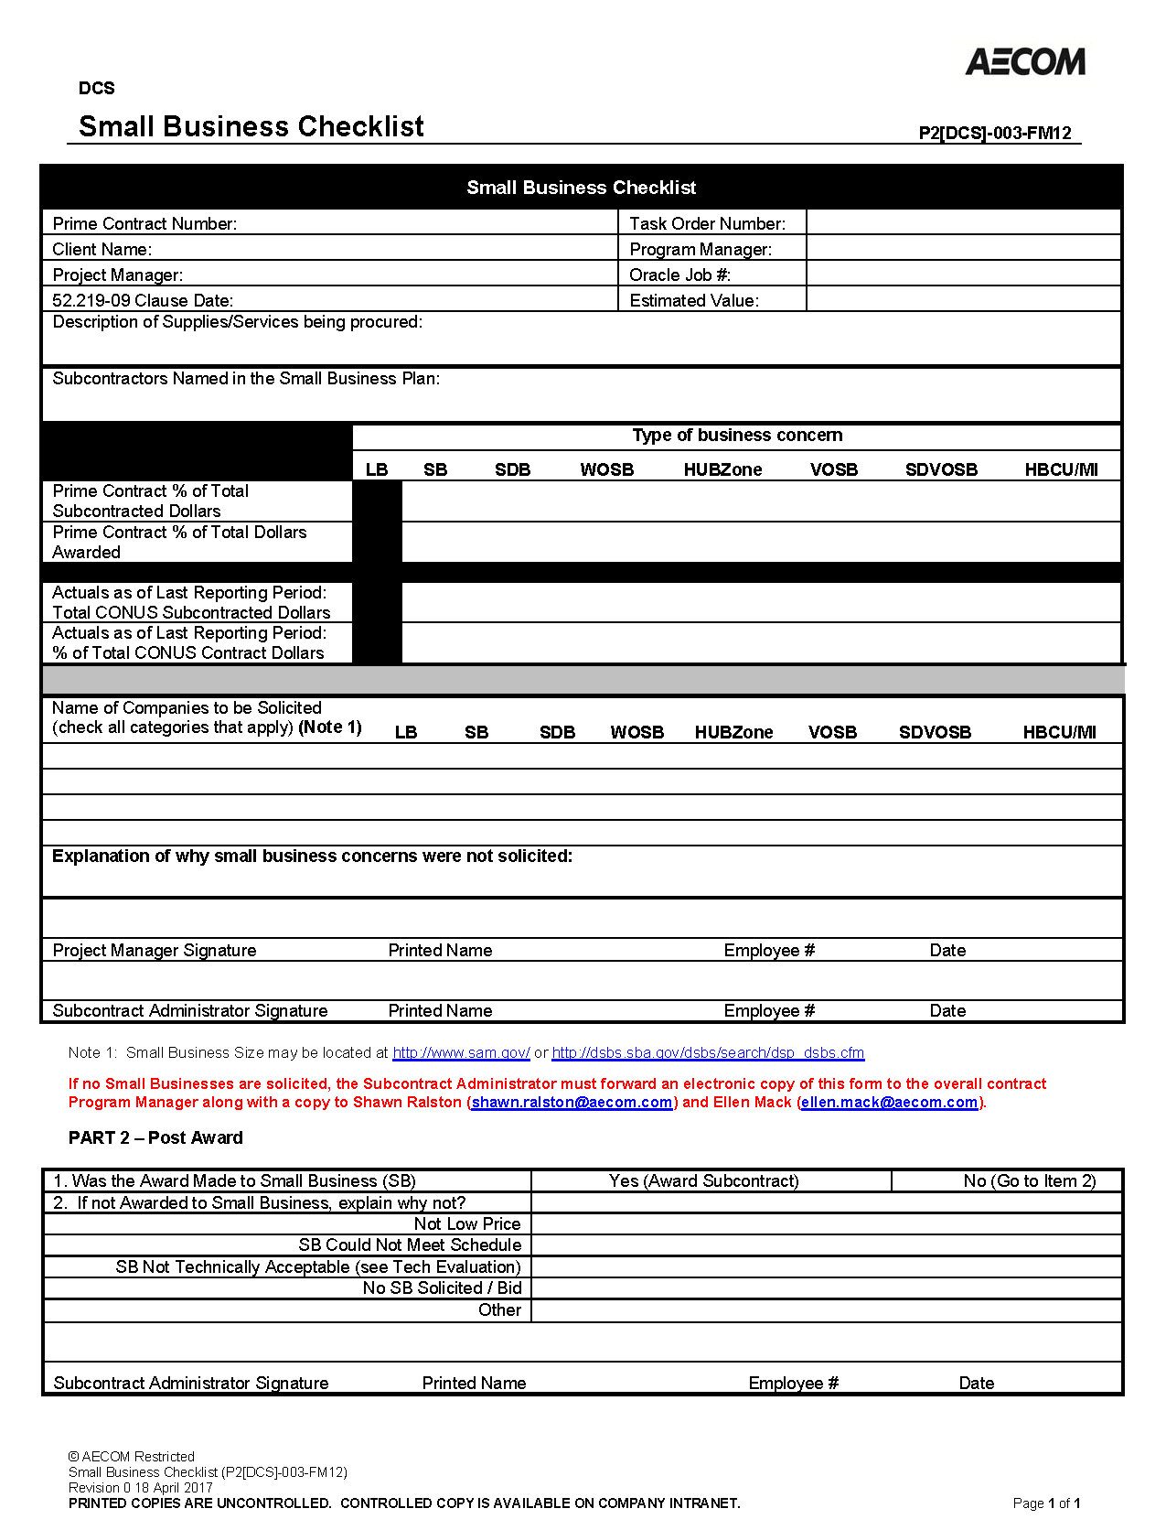
Efforts to Promote SB & Meet Goals
SB Performance Reviews
We hold one-on-one sessions with AECOM Program Managers for every newly awarded contract to go over the plan approach to meet our SB goals. We review named SB subcontractors and resources available to them and strategies for goal attainment.
We also hold sessions with Program Managers when SB goals are provided, we seek to identify SB firms in the various categories that will allow us to meet all goals by contract completion
SB Incentive Award
Monetary Award made quarterly within our procurement group to the individual that has had the biggest impact on SB goal performance
SB Check List
Used when not soliciting a SB. Required to be signed by the SCA, PM, and approved by the SBLO
Includes contract level SB goals, our progress against those goals, and the named SB subcontractors in the proposal/subcontracting plan
Recognition of AECOM Program Managers

Slide 5
Individual Subcontract Report (ISR)
AECOM’s Process Ensures Accountability of Program Managers
For every ISR we submit, we work closely with each of our Program Managers to ensure that comments provide a full description of the efforts we are making on each contract.
Program Managers commonly engage Project Managers to provide specifics on efforts we have made or challenges we have faced in incorporating the various types of SBs. This is common on our IDIQ contracts.
For contracts where the PM is not fully engaged or progress is slow, we will add that contract to our SB Performance Review lists for the next period.
The ISRs that are submitted become SB Past Performance so it vital to capture challenges, success, and other details that put the performance in context
There is no limit to the amount of information that goes into the Remarks section. We typically list our firm’s SB outreach activities but also encourage Program Managers to list specific outreach or SB searches they conducted in support of their contract.
Some clients require a TO accounting of efforts. These require Program Mangers to keep track throughout the year of efforts on individual TOs

Slide 6
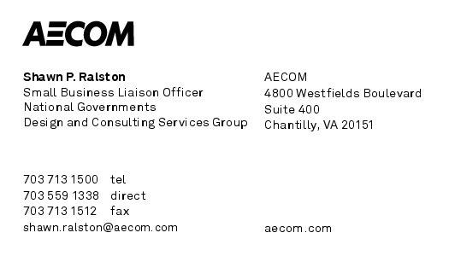
Questions?

