Slide 1
Mechanical control system integration – “What’s in it for you?”
Presenters: Rick West, Paul Panter, Matt Price & Joe Marcano
Date: February 8, 2018
Location /Event: 2018 USACE/SAME Meet the Corps Day
Tulsa Technology Center, Owasso, OK

Slide 2
ABSTRACT/OBJECTIVE
Presentation will outline the motivation and objectives underlying the re-focused emphasis on Mechanical Control System Integration and provide an overview of derived benefits realized during initial project implementation.
Both government and industry perspectives will be presented along with actual process scenarios to demonstrate the resulting paradigm shift.
Introductions & Credits
Douglas Hartwig (Crafton Tull)
Bob Streets (Benham/Leidos)
Eric Slater (USACE, Tulsa)
Notes:
29 Feb 16 – Paul Panter & Rick West collaborate/benchmark w/input from Douglas Hartwig (Crafton Tull) & Bob Streets (Benham/Leidos)
Eric Slater – played a key role in refining/finalizing new Integrator requirements
Construction Contractors & A/E Design partners

Slide 3
Fort Sill Area “Top 5” keys to success
5. Early Problem Identification
HVAC System Commissioning (Cx) Challenges
Problems identified too late to prevent adverse schedule impact. Potential contributors include:
Untimely selection/submittal of major equipment items
Major equipment components often procured from multiple manufacturers/vendors (e.g. not “Plug & Play”)
Absence of defined control modes over the full range of system operation (dead zones)
Operational sequences/integration points on equipment with packaged controls not fully defined/detailed
Integration of Dedicated Outside Air Units (DOAU’s) w/bldg DDC controls is especially problematic
Earlier collaboration by all stakeholders required

Slide 4
Fort Sill Area “Top 5” keys to success
5. Early Problem Identification (Cont’d)
Potential Mitigation Measures
Require earlier selection/submittal of all major equipment
Require sequence of operation “dry run” w/key stakeholders
Require overlay of psychrometric chart w/planned operational control modes and trigger points for design degree days to check for possible “dead” zones
Document Cx Lessons Learned as a tool to promote process improvement
Consider requirement for a “Mechanical System Integrator”
Be Part of the Solution!

Slide 5
CX Lessons Learned ➔ initial focus areas
Initiate a collaborative exchange with all mechanical stakeholders to fully develop the construction logic sequence and durations for Test, Balance & Commissioning (TB&C) activities
Review/verify the proposed sequence of operation and validate system design w/full participation by the Contractor, Designer of Record, Cx Authority and Mechanical/Controls subcontractors
Overlay the psychrometric chart with planned operational control modes for a design degree day and check for possible “dead” zones
Start by plotting all control sequence trigger points
Review all leaving coil discharge air temperatures as a qualitative check of system performance/capacity
Integrate graphical trends of system operation into the controls start-up report; ensure functional performance is smooth over the full band of operation
Notes:
Slide briefed by Rick West
Arrange a collaborative exchange with all mechanical stakeholders to fully develop the construction logic sequence and durations for Test, Balance & Commissioning (TB&C) activities -- Place emphasis on identifying the process steps, interrelationships and durations of each activity.
Review/verify the proposed sequence of operation and validate system design w/full participation by the Contractor, Designer of Record, Cx Authority and Mechanical/Controls subcontractors – essentially a dry run or pre-construction check of the planned control sequence.
Overlay the psychrometric chart with planned operational control modes for a design degree day and check for possible “dead” zones; start by plotting all control sequence trigger points. Look for inconsistencies in the Sequence of Operation or with the control trigger points; make sure there is a defined control mode over the full operating spectrum and ensure that control functions are driven by conditions with the least number of variables.
Review all leaving coil discharge air temperatures as a qualitative check of system performance/capacity – coil discharge temperatures above the required dewpoint conditions is reason for concern and indicative of problem.
Integrate graphical trends of system operation into the controls start-up report; ensure functional performance is smooth over the full band of operation. Ensure that established performance criteria are met over all conditions and that sequences are tuned to avoid large variants, especially during transition between operational stages.

Slide 6
Systemic Problems Continue to Drive Need for Further Change
1. Problem Identification:
“Multiple Cooks in the Kitchen”
Design/Process Engineer – writes functional requirements; identifies software, network and interface requirements to include input/output points (i.e. how equipment is to operate).
Control sub – develops the software code/algorithm used to drive system operation.
Multiple methodologies are available to drive control loop feedback – Proportional, Integral, and/or Derivative (PID)
To ensure success, a true, tried and tested “Recipe” is required. Hence, the need for a …
Mechanical Control System Integrator

Slide 7
Systemic Problems Continue to Drive Need for Further Change
2. Where do we go from here?
Involve Designer, CxA, TAB Ktr, Mechanical Sub, Controls Team & Owner in the process from day 1
Hire an independent equipment start-up firm/Mechanical Integrator to conduct control forensics [evaluate controls using “what if” technique]
(1) prior to design to review process flow diagrams &
(1) after design & prior to construction
Establish communication with equipment suppliers and review PID control sequence up front. [Quality control is better managed at the factory than in the field.]
Develop/implement validation checklists to include: Installation Quality/Operation Quality/Performance Quality

Slide 8
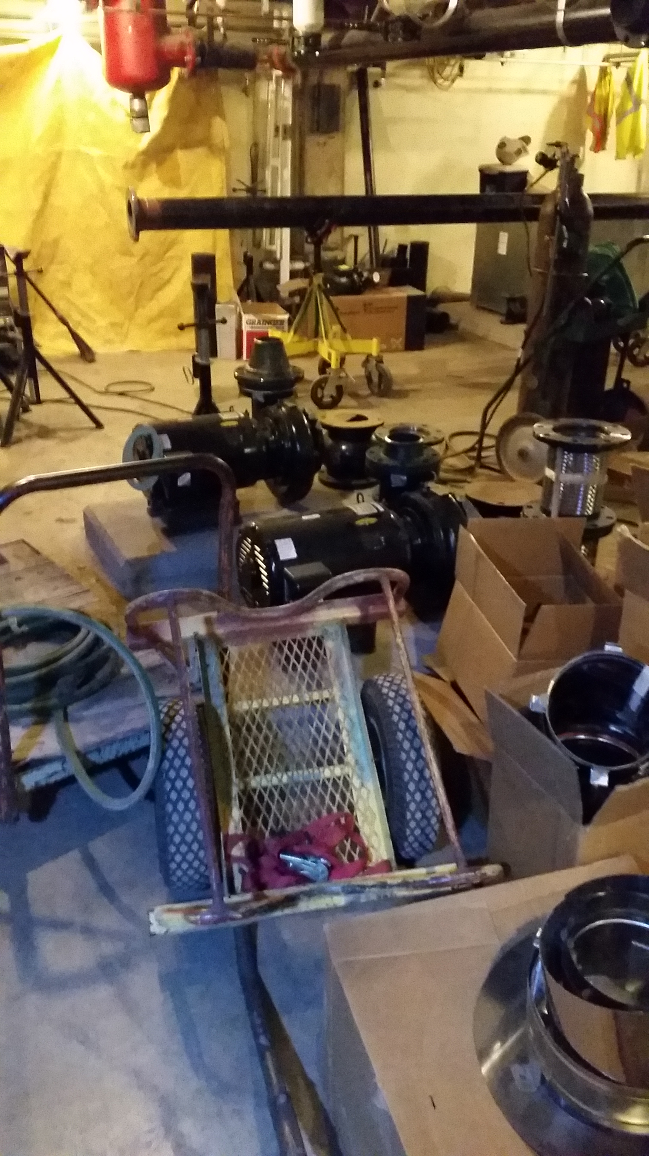
Benefits Derived from the Mechanical control system Integrator
Design/Bid/Build Project: Fort Sill, OK: Replace HVAC Building 2025
During their design review the Integrator discovered a potentially serious problem which eventually would have led to an overheat condition of the Fluid Cooler and geothermal piping loops. An overheat condition may not have been discovered until sometime much later when water source heat pump cooling water issues were discovered.
Overheating the geothermal loop would have adversely affected all compressor life expectancies which would have resulted in premature end of life issues.
Correction: Provide a new 3-way diverting valve in the return piping from the Fluid Cooler and revise the sequence of operation.
Notes:
Paul -- point out that using traditional Cx processes, identification of issues like this would typically not be identified until very late in the construction; i.e. during the Performance Verification Testing (PVT’s) – explain the consequence/impact.

Slide 9
Benefits Derived from the Mechanical control system Integrator (cont’d)
Design/Bid/Build Project: Fort Sill, OK: Replace HVAC Building 2025
Correction cont’d: Place the new diverting valve in the minimum position anytime the Fluid Cooler is enabled and the flow rate would be equal to all the dedicated outdoor air units (DOAU’s) by-pass flow. The remainder of the flow would be routed to the return piping which will regenerate the well field.
End Result: The Mechanical Controls Integrator discovered a cause and effect design issue that with only minor revisions of adding a 3-way valve and a matching control sequence added many years of life to not only the compressors but also the existing geothermal well system. Averted costs could be in excess of $200K.

Slide 10
Benefits Derived from the Mechanical control system Integrator (cont’d)
Design/Bid/Build Project: Fort Sill, OK: Replace HVAC Building 2025
Averted Costs & related considerations:
During new construction, more then 120 new water source heat pumps installed.
Average material cost of (1) replacement compressor is $1,500 (no labor).
The existing geothermal well field has more then 200 wells.
The average cost of installing (1) geothermal well is $4,500-$6,500
The average daily cost of (1) HVAC DDC technician is $1,200.
The average daily cost of (1) Commissioning technician is $1,000.
The average daily cost of Government involvement can be >$1,000.

Slide 11
Benefits Derived From The Mechanical Control System Integrator (cont’d)
Design/Build Project: Fort Sill, OK: Building 5970, TBUP Renovation
During their design review prior to the start of construction the Integrator discovered an issue with the sizing of the heating hot water boilers. The design for the boiler plant consisted of two 1,000 MBH gas-fired hot water boilers and two new heating hot water pumps.
The Integrator performed an independent whole building heating analysis and determined the designed capacity of the boilers was 50% lower then the actual building heating load.
The end result was that after review of design sizing calculations by both DOR and Integrator, the size of one of the boilers was increased by 100%.

Slide 12
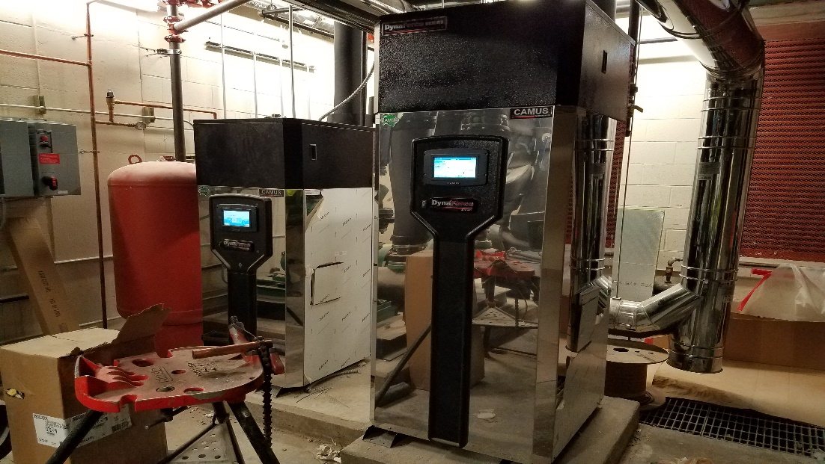
Benefits Derived From The Mechanical Control System Integrator (cont’d)
Design/Build Project: Fort Sill, OK: Building 5970, TBUP Renovation
Identification of the design issue with the heating hot water system and boiler sizing by the Integrator allowed for this correction long before any field testing took place, which would have been too late. Experience with other projects that had boiler sizing issues took several months of testing to identify and engineer “fixes” to compensate for sizing issues.

Slide 13
Benefits Derived from the Mechanical control system Integrator (Cont’d)
Design/Build Project: Fort Sill, OK: Building 5970, TBUP Renovation
Averted Costs & related considerations:
The average daily cost of (1) HVAC DDC technician is $1,200.
The average daily cost of (1) Commissioning technician is $1,000.
The average daily cost of Government involvement can be >$1,000.
Assuming that without the Integrator’s participation, the end result was that the original boiler was not changed and that it took 20 days to perform testing that finally identified the issue and then re-test the new boiler during off-season testing:
20x$1,200+20x$1,000+20X$1,000=$64,000
New boiler cost=$30,000 (not including labor).
Existing boiler (estimated) cost=$25,000(not including labor)
Equipment and testing labor=$119,000.

Slide 14
Mechanical Integrator Role
Mechanical System Integrator input helps to identify potential performance, and integration issues.
Provides another check of the HVAC design load calculations.
Defines the team and issues early before procurement begins.
Analyzes control protocols, and facilitates integration dialogue between the equipment oem, and controls contractor.
Notes:
Mechanical Control System Integrator facilitates preemptive “Forensics”; i.e. works out the “bugs” in a test scenario through early simulation. Real-time data analysis is also done at the end of the process for problem pattern identification.

Slide 15
OEM Perspective
Mechanical System Integrator provides an open dialogue between the team before the problem occurs.
Integration of equipment controls, and the control contractors equipment is a challenge.
Sequence of operation coordination.
Reading and Writing necessary points.
Factory mounted controls vs. field mounted controls.
Process provides more confidence in equipment selections.
Notes:
Matt to point out that better quality control & increased compatibility between internal equipment controls and the building automation system (BAS) through use of factory mounted controls.
Also, compare/contrast differences between the traditional Cx process and the modified process with inclusion of a Mechanical Control System Integrator.

Slide 16
THE OLD PROCESS MODEL
USACE
DOR
CxA
Mech / DDC
Notes:
Define old process model via use of Brick & Mortar Comparison – use as a transition to following slides; pointing out the various techniques used to “point up or fill the cracks”.

Slide 17
DESIGN
Mechanical System Integrator report initiates a more comprehensive and robust design review dialogue.
Identification of Psychrometric “Dead Zones”
“365 Day” control sequence analysis

Slide 18
Initial Operating Modes for 48°Dew point
Notes:
EA – entering air DB – Temp w/o moisture WB – Temp w/moisture
Design Degree Day Requirements – come from local design guides (based upon actual weather data or UFC 3-410-01). Design Guide conditions for Fort Sill cooling are 99 degrees DB and 76 degrees WB and reflect a 1% coincident/occurrence of the humidity ratio (HR) being exceeded.
Noted Chart Inconsistencies:
52 degree coil discharge temperature is above the required 48 degree DP
Between 50-55 degree DB temperature bands, there is no operating mode defined (i.e. no control to trigger required heating). The last control condition encountered would likely drive operation through this temperature range and the trigger point to drive control upon exiting the range is unclear.
Heating and cooling setpoints are errant. Per the planned sequence, cooling occurs down to 68 degrees and heating occurs up to 75 degrees; however, recent energy criteria would likely dictate the opposite (i.e. cooling down to 75 degrees and heating up to 68 degrees).
2nd Stage cooling is basically locked out for dehumidification in almost all conditions below those for a design day. This is due to original control being driven based on OA enthalpy rather than temperature coming off the enthalpy wheel (fewer variables mean more accuracy, predictability & repeatability).

Slide 19
Revised Operating Modes for 48°Dew point
Notes:
Note a clearly defined mode of operation with no “dead” zones over the entire spectrum of operation.

Slide 20
EQUIPMENT PROCUREMENT
Mechanical System Integrator input helps to better identify areas where selected equipment is incompatible with the project design.
Verifies that installed DDC hardware components allow for full implementation of the design control sequence.
Verifies that there are no elements of the internal controls programming that are in conflict with the design sequences of operation.
Notes:
Joe to introduce NEBB criteria/guidance on Peer Review. Using NEBB definitions, explain differences between Cx Review and an Additional Peer Review.
Process results in competing views until testing proves one way or the other …
“Scale Tipper” -- Mechanical Control System Integrator serves as the “Honest Broker/Tie Breaker” when there is an impasse between stakeholders. In other words, tips the scale in defining issue responsibility to drive issue(s) toward resolve.

Slide 21
DURING COMMISSIONING
Mechanical System Integrator participation provides for a more effective PVT process.
“Cellular Level” troubleshooting capability during issues resolution.
Better conflict resolution between manufacturer controls and the installed BAS.
Field Acceptance Testing (FAT) ➔ involvement of the various equipment manufacturer’s representatives & role of the Mechanical System Integrator.
Notes:
Explain ongoing issue with communication problem between DOAU’s & condensing unit at B-5970 ➔ position of staging not identified/recognized by algorithm.
- Compressors dropping out
- Not controlling to discharge requirements
- DOAU manufacturer not aware – potentially a systemic manufacturing / industry-wide problem

Slide 22
THE PARADIGM SHIFT
USACE
CxA
Mech / DDC
DOR
Mechanical Systems Integrator
Notes:
Mechanical Systems Integrator is the “Bridge” or common denominator.
The Paradigm Shift – not necessarily attributed to new technique or technology but a redirection of process emphasis to focus on preemptive analysis and early problem identification vs. identification of problems strictly through validation testing.

Slide 23
THE OLD PROCESS MODEL
USACE
DOR
CxA
Mech / DDC
Notes:
Define old process model via use of Brick & Mortar Comparison – use as a transition to following slides; pointing out the various techniques used to “point up or fill the cracks”.

Slide 24
Contact information
Rick West, P.E.
U.S. Army Corps of Engineers
Area Engineer, Fort Sill Area Office
Richard.C.West@usace.army.mil
580-581-4118
Paul Panter (CTR)
Guernsey
Mechanical Technician
Paul.R.Panter@usace.army.mil
580-581-4152
Matt Price.
Trane, Inc.
Mechanical Engineer, OKC Ofc
MPRICE@TRANE.COM
405-664-6230
Joe Marcano, NEBB CP
Southwest TAB & Commissioning
Project Manager, OKC
Joe@southwesttab.com
580-303-8242

Slide 25
Essayons!
Fort Sill Half Section

