Slide 1
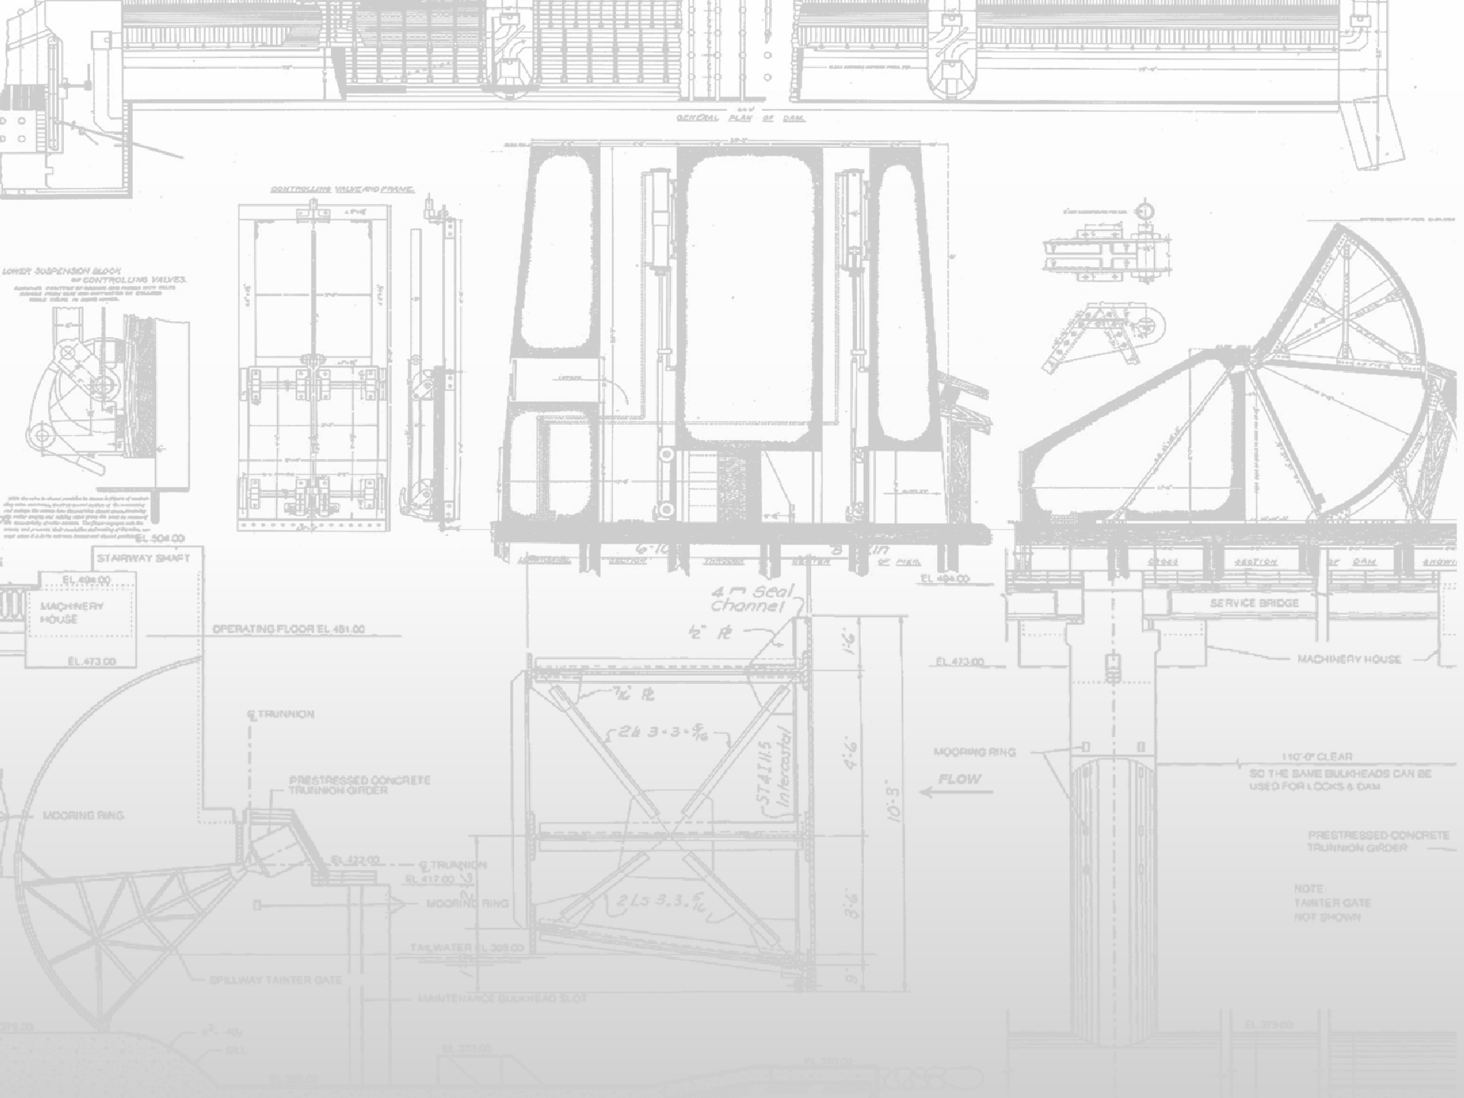
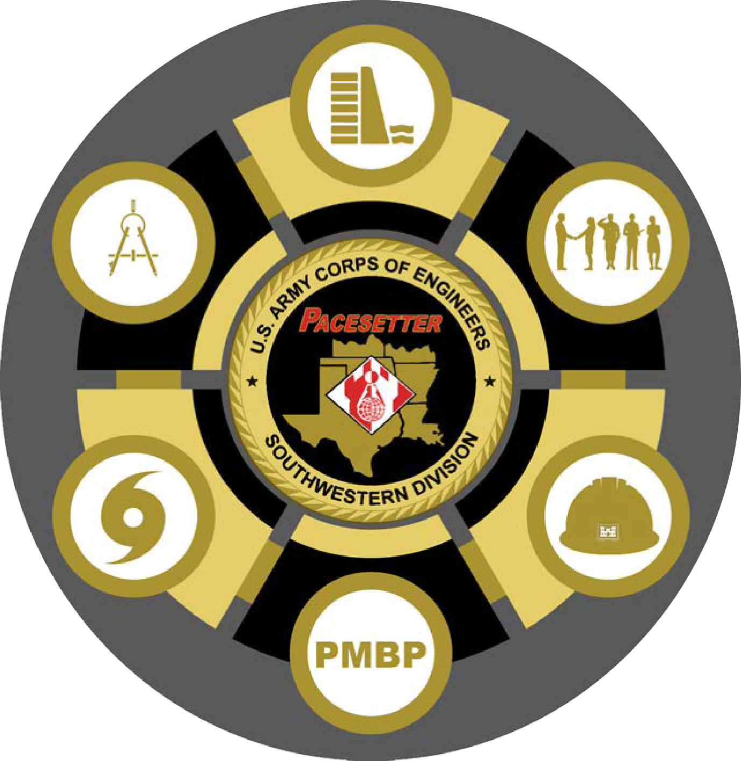
REVISING THE 1979 BROKEN BOW LAKE MASTER PLAN
Public Workshop 23 May 2022
Idabel, OK
U.S. Army Corps of Engineers, Tulsa District
File Name

Slide 2
WHAT IS A MASTER PLAN?
2
The purpose of a master plan is to establish guidelines for comprehensive management and development of all recreational, natural and cultural resources
Main focus is stewardship of natural and cultural resources and provision of quality outdoor recreation facilities and opportunities
Proposed effective life of a Master Plan is 25 years
Recreational use of the water surface is addressed
File Name: Ops Update Oct 2018.pptx

Slide 3
ADDITIONAL KEY POINTS
3
Key sections of the Master Plan Revision include
Resource management objectives
Revised land use classifications
Conceptual management plan for each land classification
Potential outcomes could be
Designation of lands for utility corridors, environmentally sensitive areas…
Protection of environmentally sensitive areas is given priority
File Name: Ops Update Oct 2018.pptx

Slide 4
WHAT MASTER PLANS ARE NOT
4
Master Plans do not address in detail the technical aspects of:
Regional water quality
Water management for flood risk management
Water supply or water level management
Shoreline management (Including boat docks, mowing, or other permits)

Slide 5
WHAT ABOUT DROUGHT/FLOOD?
5
Master Plans cannot change how water in the lake is managed, this is addressed in a separate Water Control Plan
Natural resources and recreation management must be implemented within the constraints of the primary missions of flood risk management and water supply

Slide 6
Why Revise MASTER PLAN?
6
Revision is needed to incorporate any changes in Public Law
Current Master Plan is dated June 1979 and has exceeded its useful life. The way the Lake is managed today is different from the vision set forth in the 1979 plan
Need to re-examine Land Classifications
The Master Plan must be revised to address current and projected future growth in the region

Slide 7
What Revisions Can You Propose?
7
Re-examine the classification of all project lands
Re-examine the classification of all project water surface
Resource Management Objectives
Recreation Management Objectives

Slide 8
NATIONAL ENVIRONMENTAL POLICY ACT
8
The MP Revision process includes compliance with the National Environmental Policy Act (NEPA) of 1969.
Purpose of NEPA is to:
Ensure federal agencies give proper consideration to the environment prior to undertaking a federal action.
Involve the Public (scoping) in the decision-making process.
Document the process by which agencies make informed decisions.
NEPA Scoping Process:
Opportunity for Public comments and questions on the potential impacts of proposed federal actions.
Includes comments by other federal, State, and local governments, and American Indian Tribal Nations.

Slide 9
NEPA Includes:
9
Public exchange of information related to problems to be solved, issues to be addressed, and potential alternatives.
Identification and evaluation of a broad range of alternatives.
Identification and quantification of potential impacts.
Screening of non-relevant issues from analysis.
Documentation of analysis and coordination through preparation of NEPA documents, such as an Environmental Assessment (EA) or an Environmental Impact Statement (EIS).
Federal, State, and Public review of NEPA documents.

Slide 10
What Types of Comments Can You Submit under NEPA?
10
NEPA requests your input on the proposed revision of the Broken Bow Lake Master Plan and the potential environmental impacts of that action.
Broadly, covers any aspect of the natural and human environment.
Some examples of comment categories might include:
Recreation availability and access;
Fish & wildlife habitat;
Public access to federal land;
Economic impacts;
Cultural resources; or
Water and air quality.

Slide 11
NEPA RESOURCES
11
Available on NEPAnet: http://www.NEPA.gov
NEPAnet Includes:
A Citizen’s Guide to NEPA – Having Your Voice Heard
Council on Environmental Quality Regulations for Implementing NEPA (40 CFR Parts 1500- 1508)

Slide 12
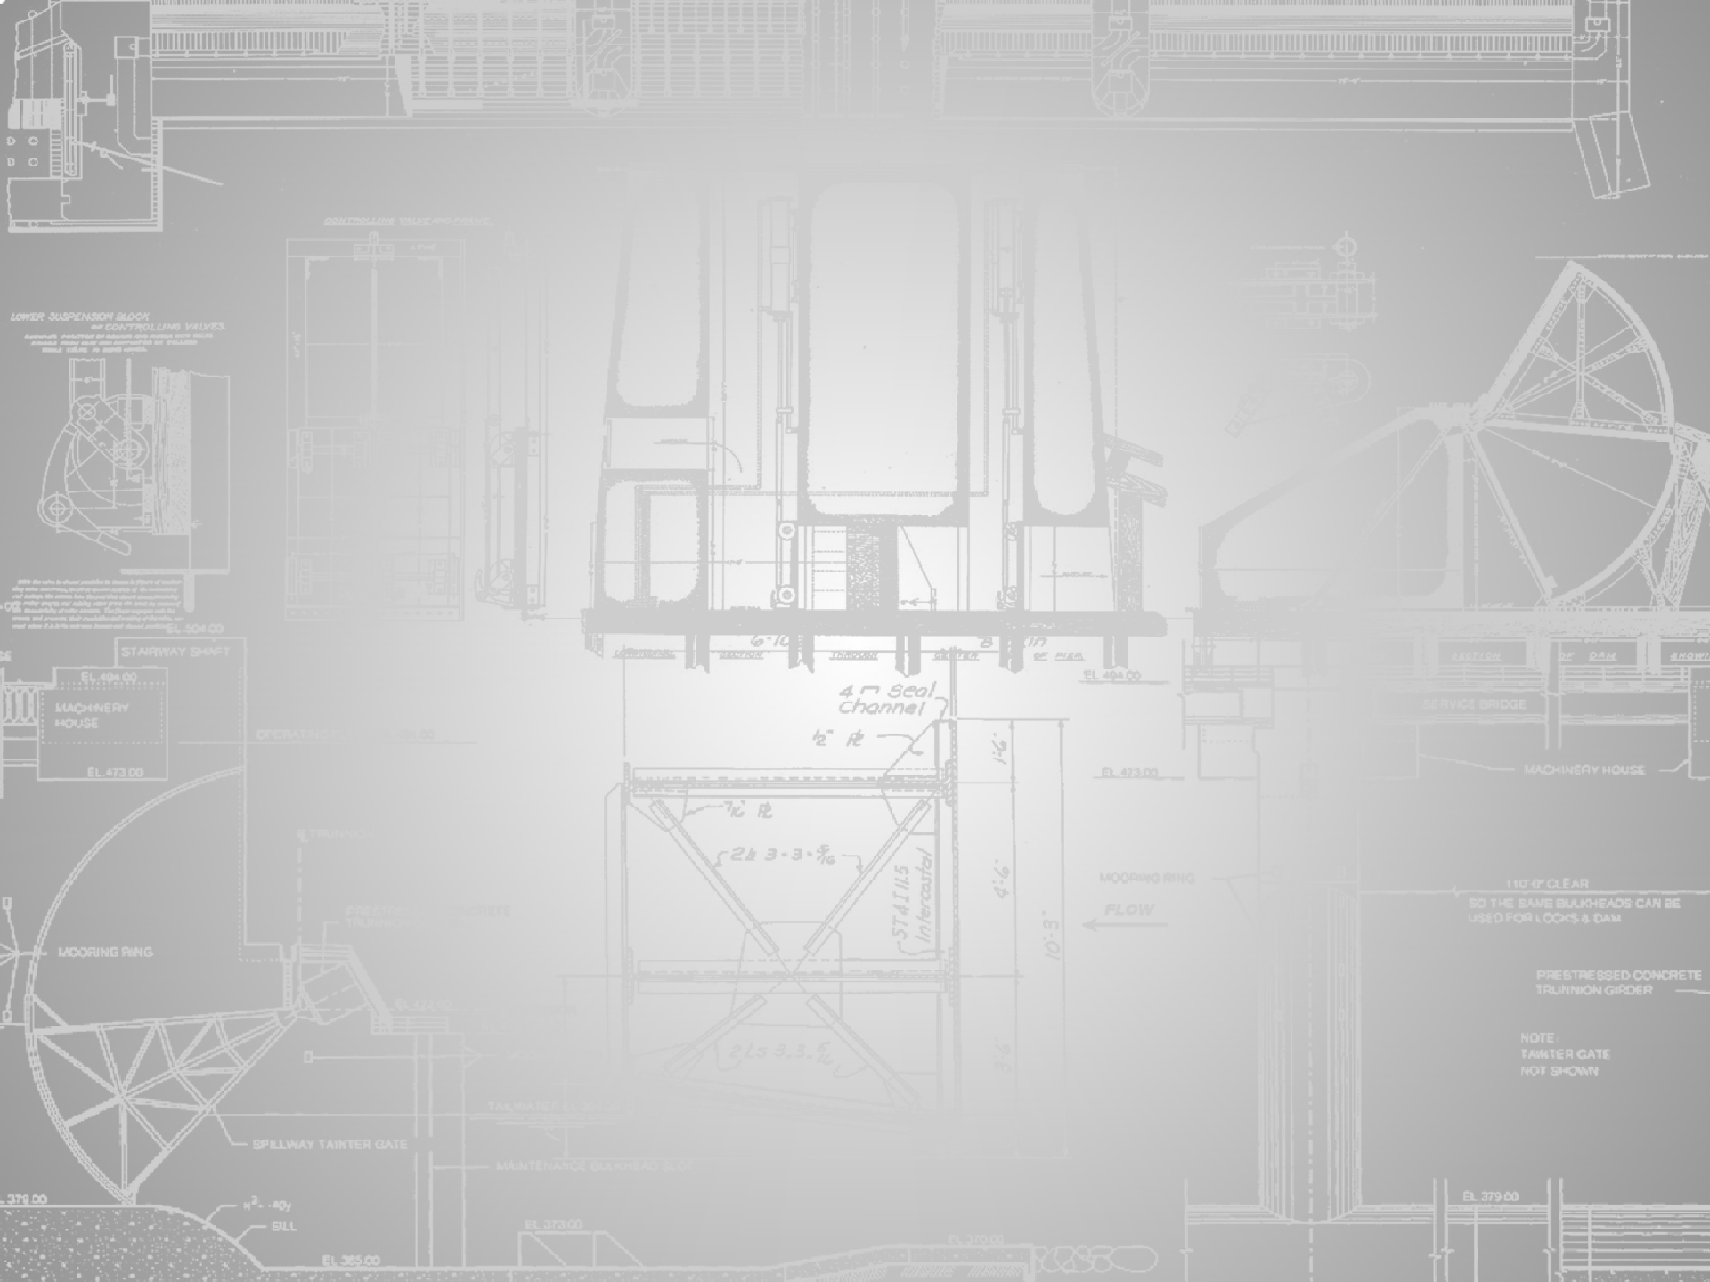
THE MASTER PLAN REVISION PROCESS
Data Collection
Agency/Public Scoping
23 May 2022
Analysis by Planning Team
Draft Plan Prepared
Agency/Public Review (30 days)
April 2023
Finalize Master Plan Based on Comments Received
Adoption of Final Master Plan December 2023
Where we are today

Slide 13
How can you participate?
13
Review the below documents at website: https://www.swt.usace.army.mil/Missions/Recreation/Master
-Plans/
Public Meeting PowerPoint
Existing Broken Bow Lake Master Plan
Broken Bow Master Plan Update Comment Instructions
Broken Bow Lake Master Plan Comment Form
USACE Master Planning Policies and Procedures
Submit a comment with your input on the proposed MP revision.

Slide 14
Broken Bow Lake Master Plan Revision Comments
14
SUBMIT YOUR COMMENTS:
Using comment forms available at this Public Meeting
You may download the comment form provided on the website, fill it out electronically, and email it to the Corps using the submit button on the comment form.
by mail: Shae Harrison, Broken Bow Lake Manager; P.O. Box 99, Sawyer, OK 74756
or
by email: CESWT-OD-RBRBSWT@USACE.ARMY.MIL

